Slide 1
SPI Module
HCM - 18/09/2020

Slide 2
SPI introduction and overview
Physical interface
Daisy chain configuration
Data transmission
Clock polarity and phase
Applications
SMT32 SPI

Slide 3
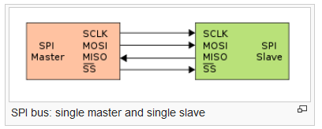
SPI – Physical interface
Physical Interface
  The SPI bus specifies four logic signals:
  SCLK : Serial Clock (output from master).
  MOSI : Master Output, Slave Input (output from master).
  MISO : Master Input, Slave Output (output from slave).
  SS : Slave Select (active low, output from master).

Slide 4
SPI - Features
Shorted for Serial Peripheral Interface
Synchronous (Clock) serial communication
Full-duplex (2-ways) communication
A master-slave architecture with a single master
Multiple slaves supported
Not limited for data size transferred (SPI, QSPI, OctaSPI)
Not limited to any maximum clock speed
Used for short distance normally in a PCB board

Slide 5
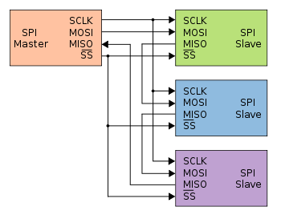
SPI- Daisy chain configuration
The first slave output being connected to the second slave input
The SPI port of each slave sends out during the second group of clock pulses an exact copy of the data it received during the first group of clock pulses.

Slide 6
SPI- Data transmission
The bus master configures the clock, then selects the slave device (CS = 0). The master must wait for a delay time before issuing clock cycles (Wait slave finishes setup).
The master sends a bit on the MOSI (Master Output) line and the slave reads it, while the slave sends a bit on the MISO line (Slave Output) and the master reads it
Transmission may continue for any number of clock cycles
When complete, the master stops toggling the clock signal, and typically deselects (CS=1) the slave.

Slide 7
Applications
SPI is used to talk to a variety of peripherals, such as:
  Sensors: temperature, pressure, ADC/DAC, touchscreens, video game controllers
  Control devices: audio codecs, digital potentiometers, DAC
  Memory: Flash and EEPROM
  Any MMC or SD card
  Communications: Ethernet, USB, USART, CAN, IEEE 802.15.4, IEEE 802.11, hand-held video games

Slide 8
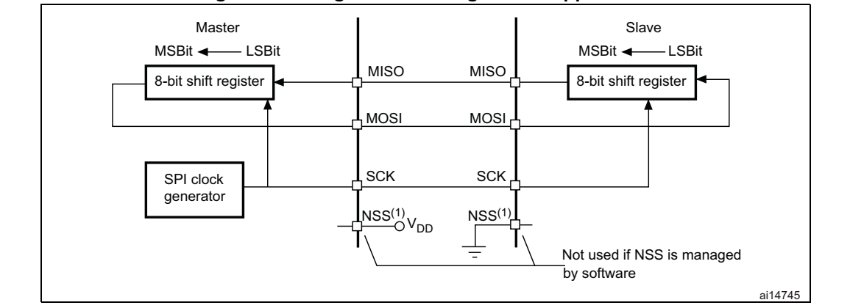
Single master/single slave
Single master/ single slave application

Slide 9
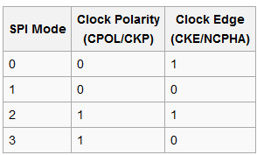
Clock polarity and phase
In setting the clock frequency, the master must configure the clock polarity and phase with respect to the data.
There are 4 modes for setting the clock frequency.

Slide 10
SPI Timing
A clock polarity (CPOL) of
  0 means that the clock line idles low
  1 means the clock line idles high
If clock phase (CPHA) is 0:
  bits are sampled (reading) on the leading clock edge (first clock edge)
if CPHA is 1:
  bits are sampled (reading) on the trailing clock edge (second clock edge)

Slide 11
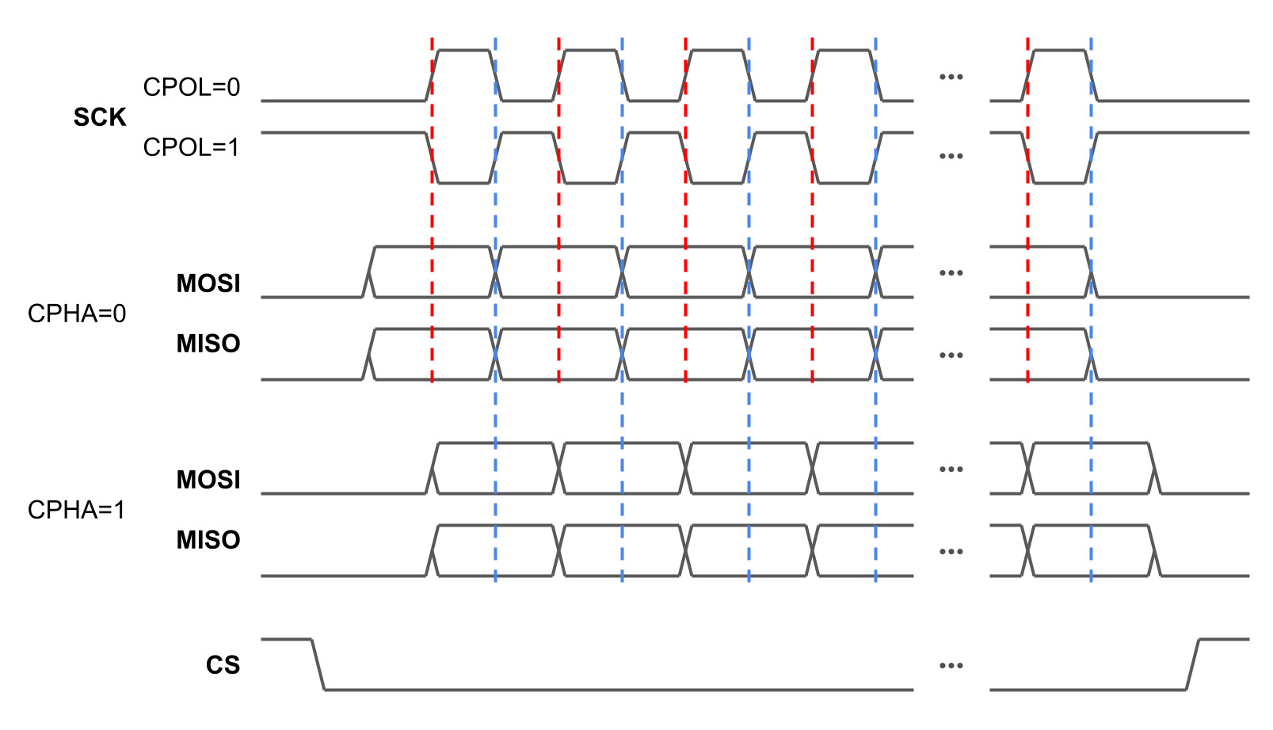
SPI Timing

Slide 12
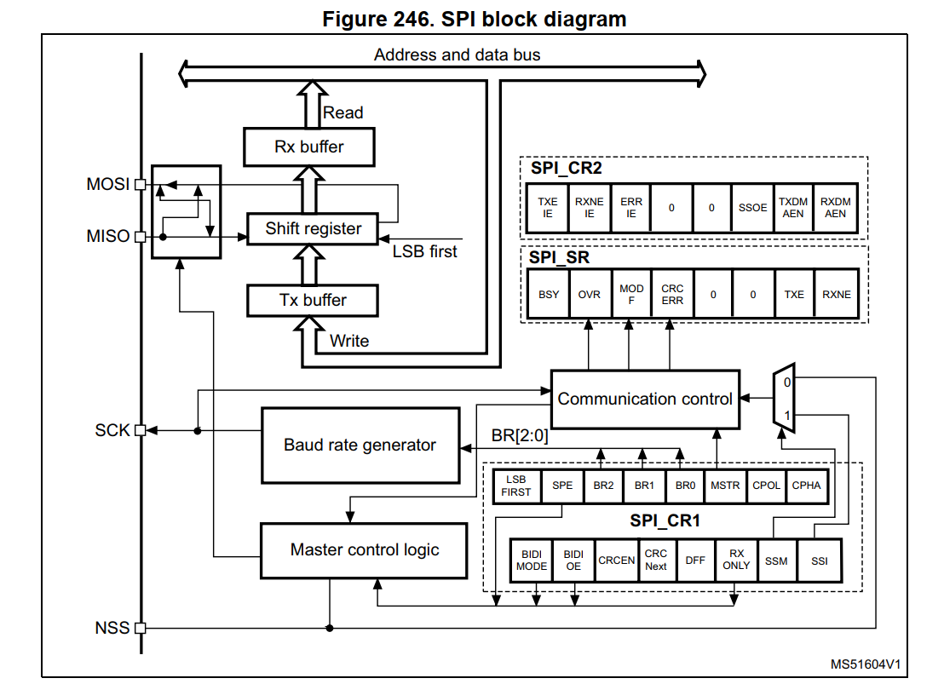
STM32 SPI

Slide 13
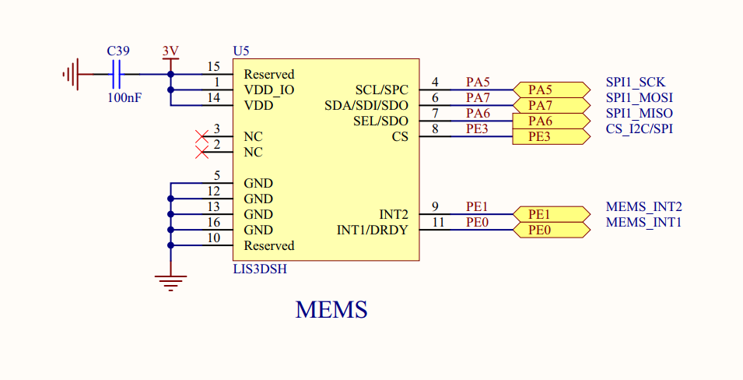
SPI MEMS Sensor - accelerometer
CS = PE3
SPI1_NSS = PA4
=> Use GPIO for Chip Select Pin (Software NSS)

Slide 14
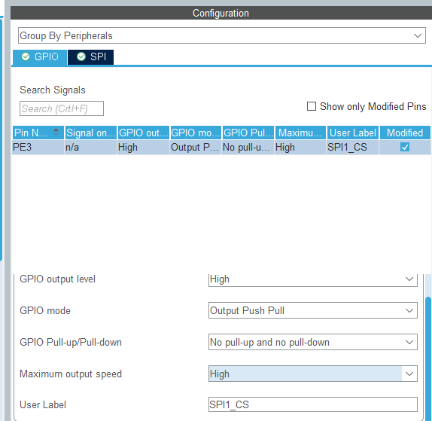
Cấu hình chân Chip Select

Slide 15
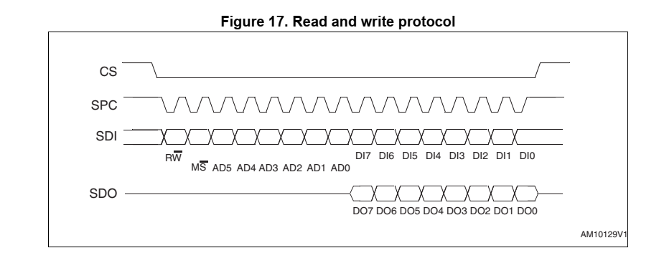
L3GD20H – SPI Timing
Bit R/W: 0 = Write, 1 = Read
Address: AD5 – AD0 = Register Address, MS = Multiple
=> Frame size = 8
=> First bit = MSB (D7 – D0)

Slide 16
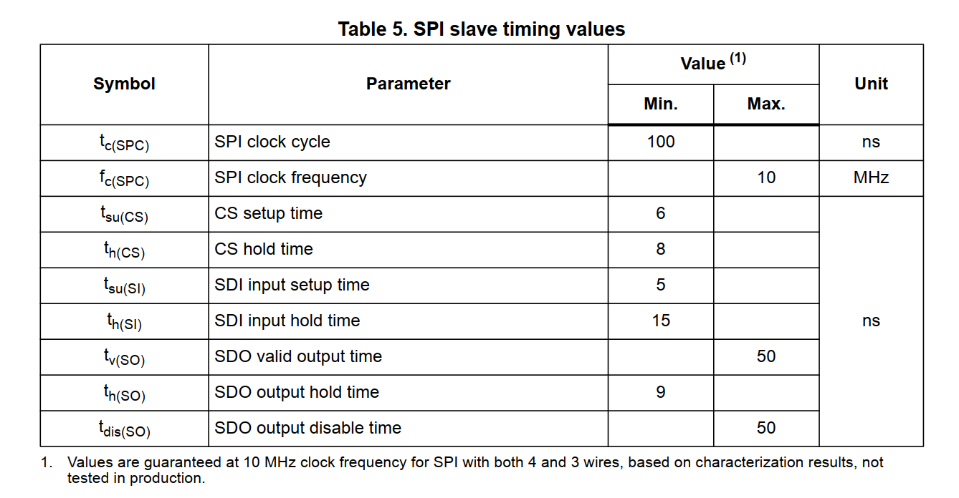
SPI Speed
Max clock = 10MHz
Nominal = Max / 2 = 4-5MHz

Slide 17
L3GD20H – SPI Mode
CPOL = 1 (1 means the clock line idles high)
CPHA = 1 (bits are sampled (reading) on the trailing clock edge)

Slide 18
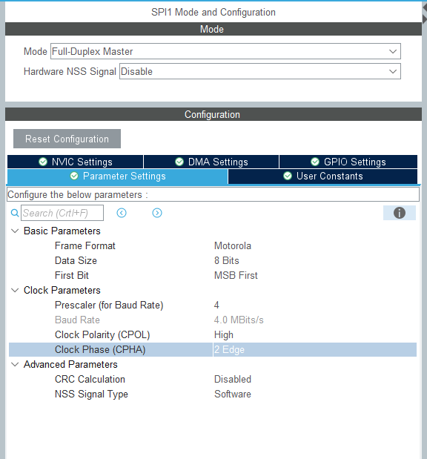
CubeMX Setting

Slide 19
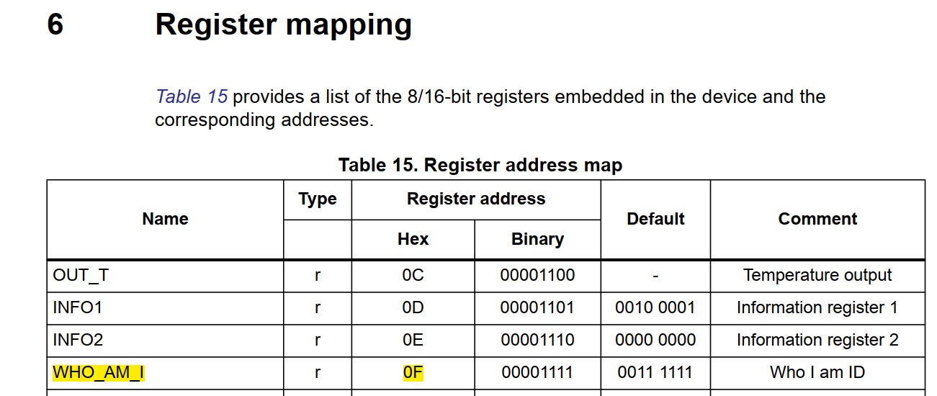
Register Mapping - lis3dsh
Default WHO_AM_I = 0011 1111 = 0x3F

Slide 20
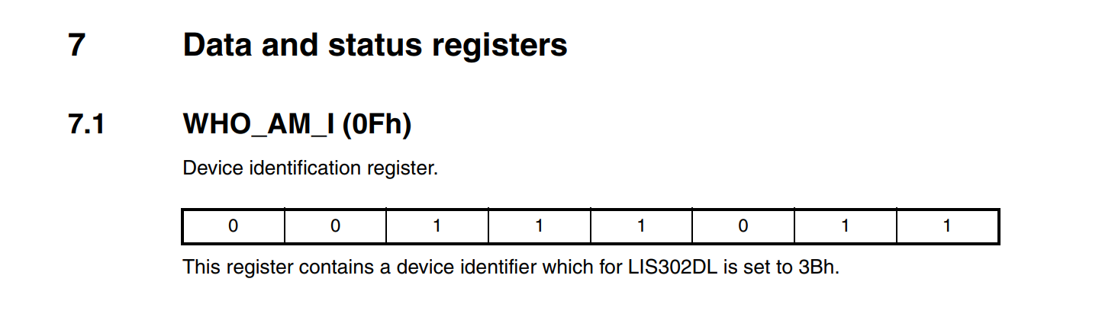
Register Mapping - lis302dl
Default WHO_AM_I = 0011 1011 = 0x3B

Slide 21
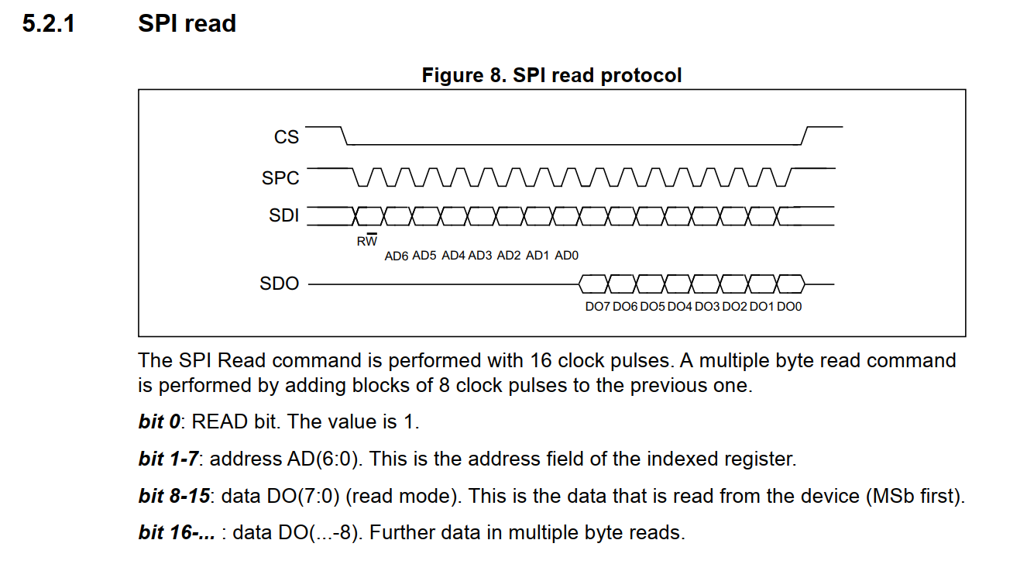
Sensor Data Frame
R/W = 1 (Read)
AD6 – AD0 = Register Address = 0x0F

Slide 22
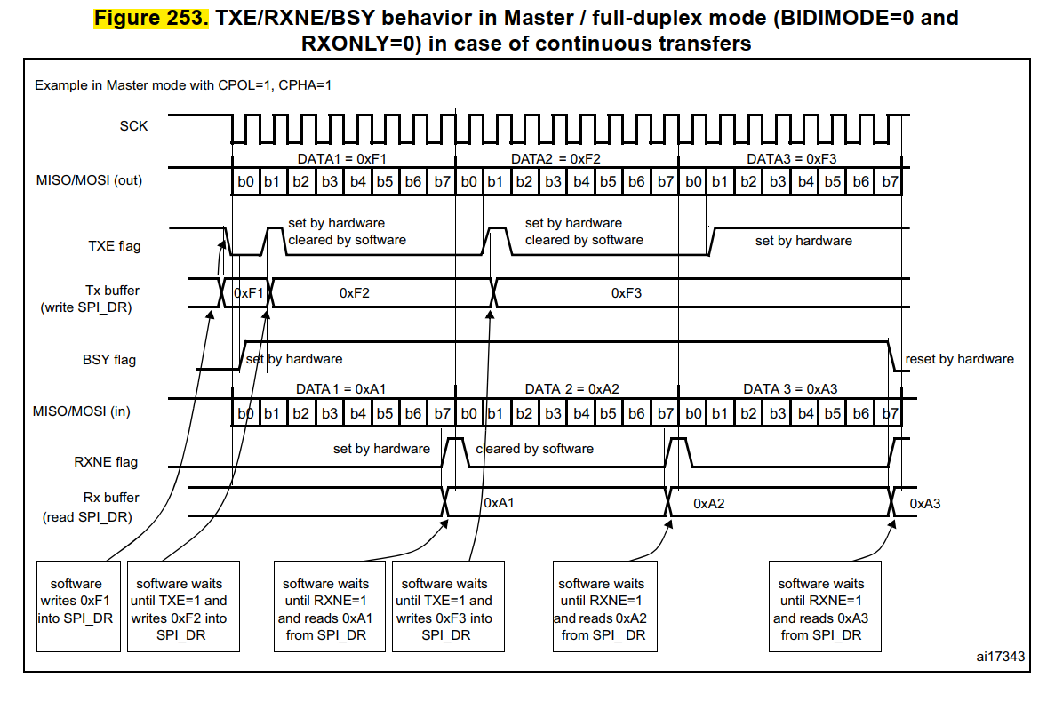
SPI Transmission Timing

Slide 23
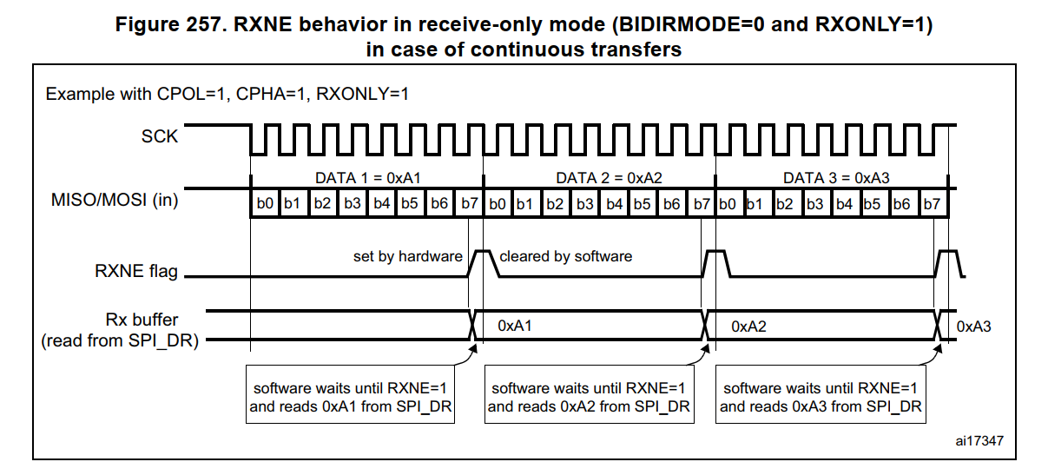
SPI Receive Timing

Slide 24
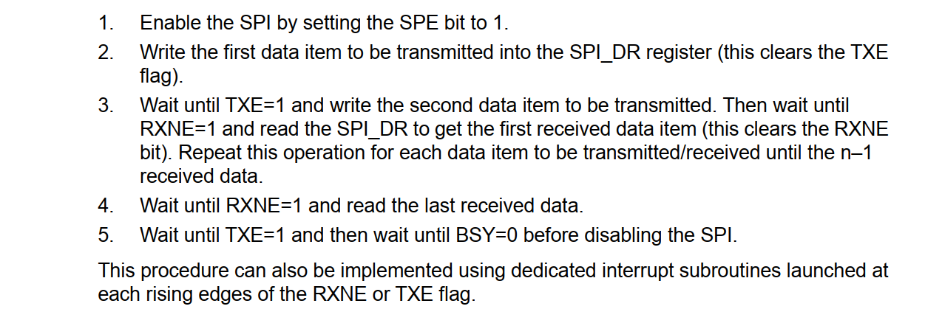
Programming Procedure

Slide 25
Q&A

